Slide 1
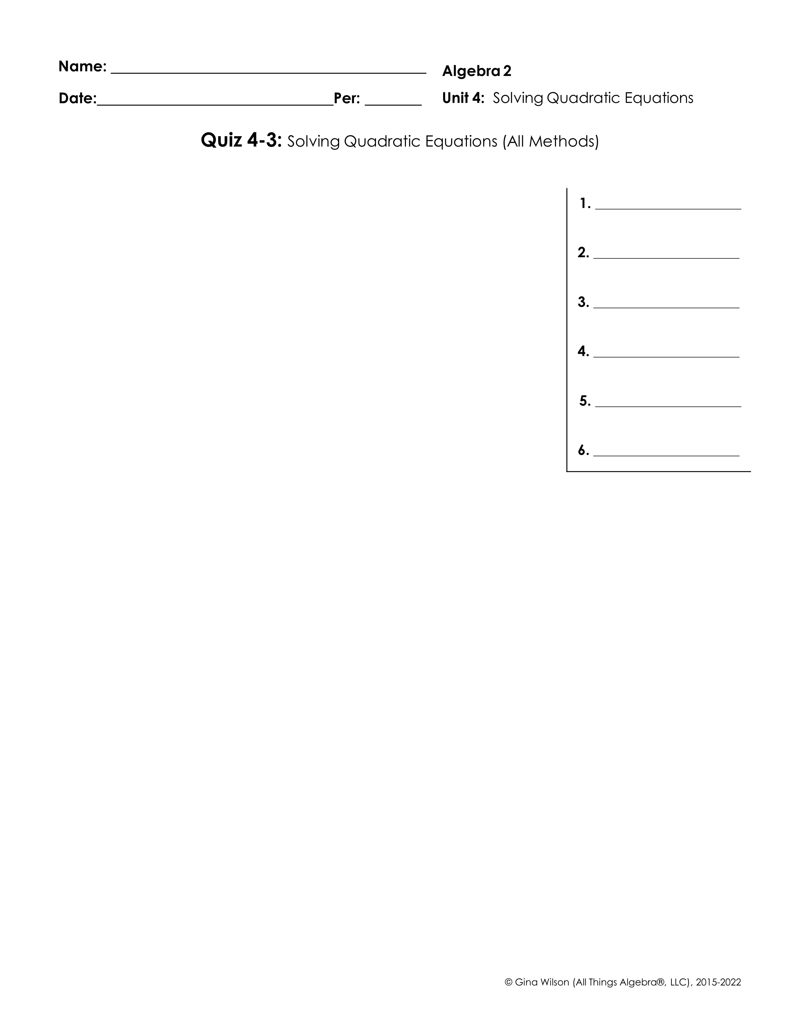
Solve by factoring:
1.
2.
Solve by square roots:
3.
4.
Solve by completing the square:
Solve by the quadratic formula:
5.
6.

Slide 2
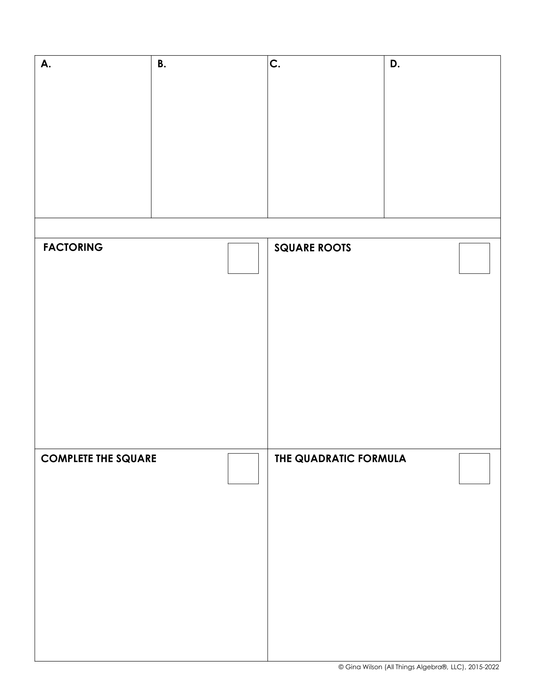
7. Step 1: Find the discriminant of each equation, then determine the number and type of solutions.
Step 2: Solve each equation using the methods below. Each method may only be used once.

